Slide 1
Perceptron and Multilayer Perceptron
Protopapas

Slide 2
Outline
Introduction to Artificial Neural Networks
Review of basic concepts
Single Neuron Network (‘Perceptron’)
Multi-Layer Perceptron (MLP)

Slide 3
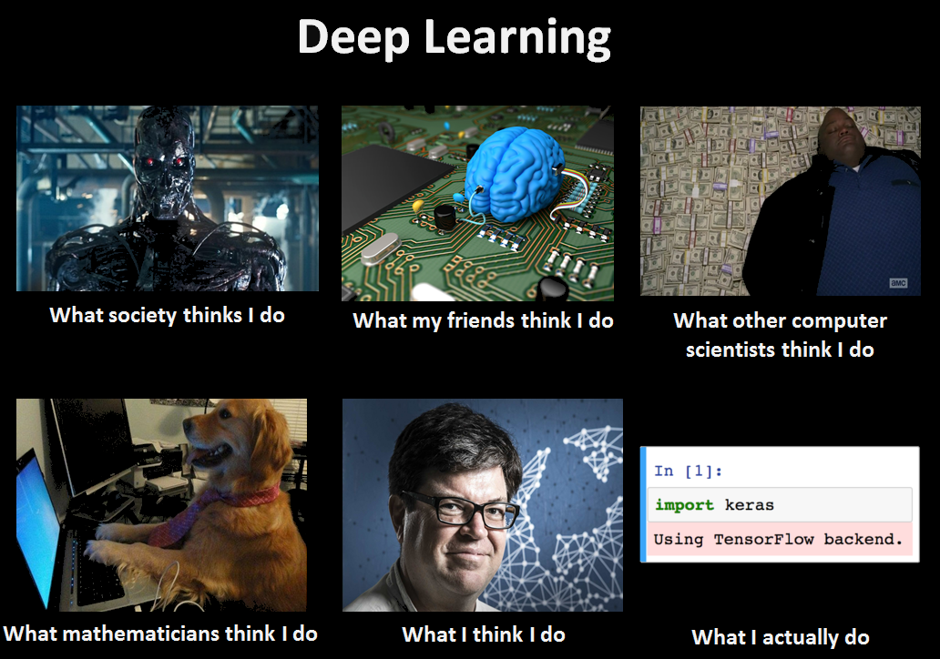

Slide 4
Watch this!
http://video.arstechnica.com/watch/sunspring-sci-fi-short-films

Slide 5

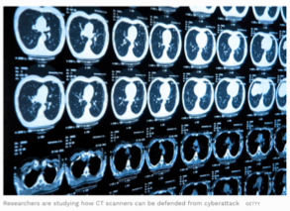

Today’s news
Stopping Cyberattacks
Skin Conditions
Detecting tampering with the diagnostic images, or quietly upped the radiation levels.
Using Deep Learning in diagnosing skin conditions

Slide 6

Today’s news
Image generation
Computer Code Generation
Katie Bouman’s CHIRP produces the first-ever image of a black hole.
Notes:
https://www.youtube.com/watch?v=PQCrX1sQSzY

Slide 7



The Potential of Data Science
Gender Bias
Racial Bias
Some DS models for evaluate job applications show bias in favor of male candidate
Risk models used in US courts have shown to be biased against non-white defendants

Slide 8
Historical Trends

Slide 9
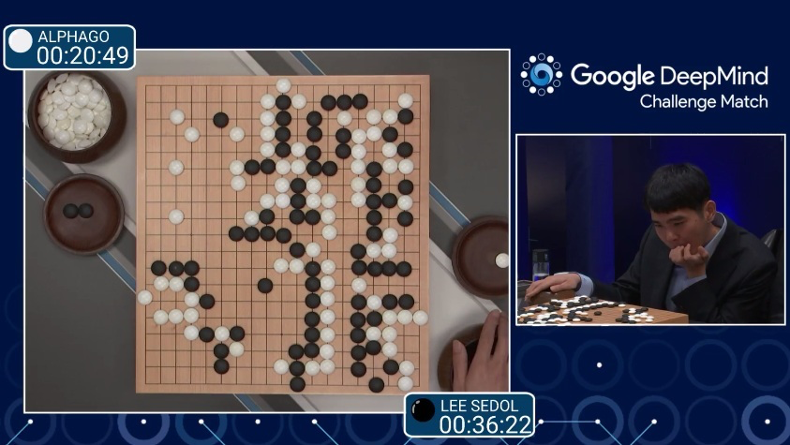
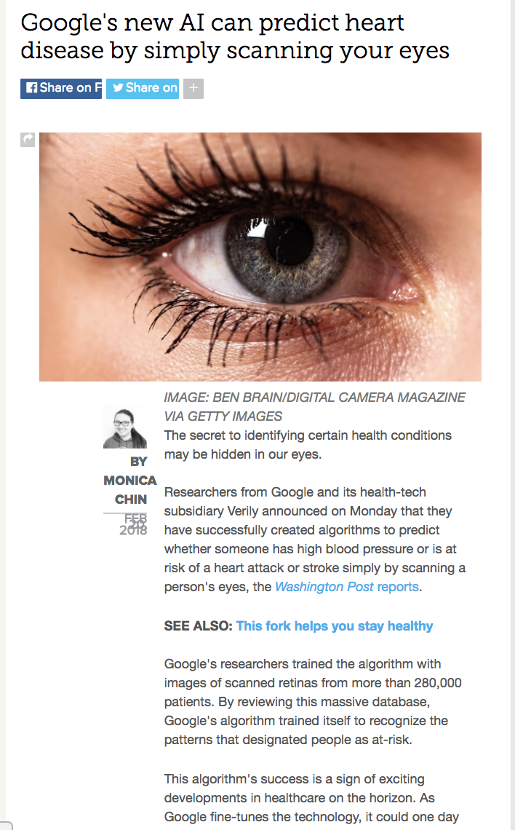
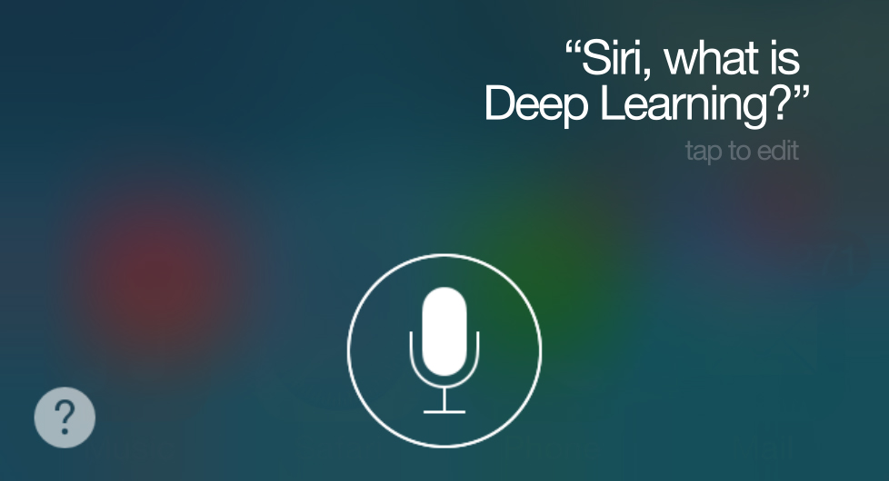

Historical Trends
Disease prediction
Game strategy
Natural Language Processing
2016
2018

Slide 10
Historical Trends
ArXiv papers on Machine Learning and Artificial Intelligence: 2007-2019

Slide 11
Outline
Introduction to Artificial Neural Networks
Review of basic concepts
Single Neuron Network (‘Perceptron’)
Multi-Layer Perceptron (MLP)

Slide 12
Classification example: Heart Data
response variable Y
is Yes/No
Age | Sex | ChestPain | RestBP | Chol | Fbs | RestECG | MaxHR | ExAng | Oldpeak | Slope | Ca | Thal | AHD
63 | 1 | typical | 145 | 233 | 1 | 2 | 150 | 0 | 2.3 | 3 | 0.0 | fixed | No
67 | 1 | asymptomatic | 160 | 286 | 0 | 2 | 108 | 1 | 1.5 | 2 | 3.0 | normal | Yes
67 | 1 | asymptomatic | 120 | 229 | 0 | 2 | 129 | 1 | 2.6 | 2 | 2.0 | reversable | Yes
37 | 1 | nonanginal | 130 | 250 | 0 | 0 | 187 | 0 | 3.5 | 3 | 0.0 | normal | No
41 | 0 | nontypical | 130 | 204 | 0 | 2 | 172 | 0 | 1.4 | 1 | 0.0 | normal | No

Slide 13
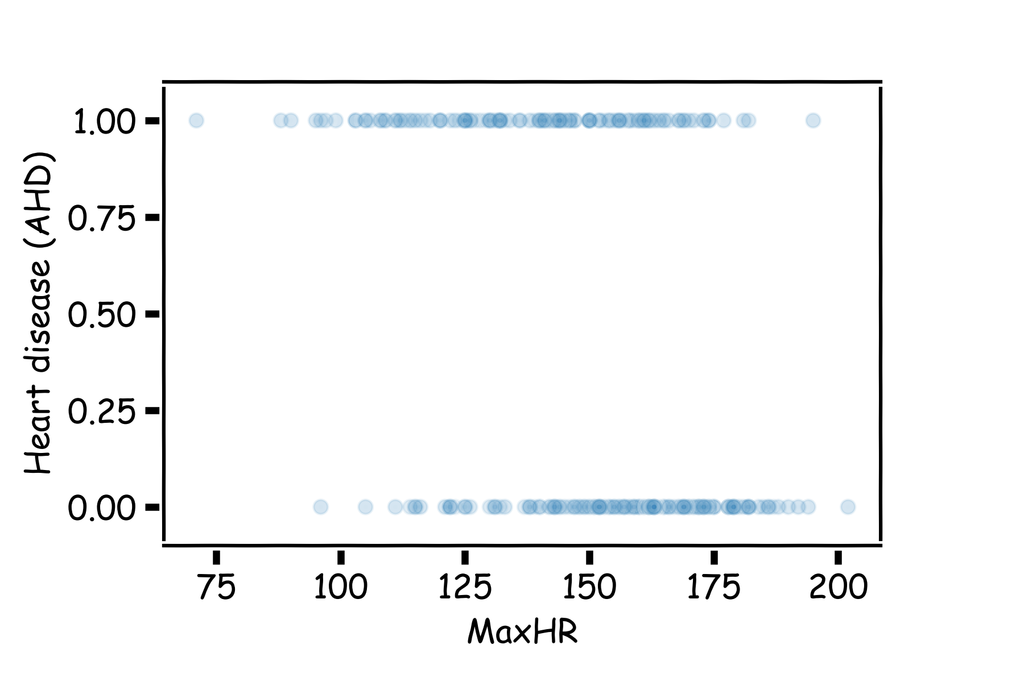
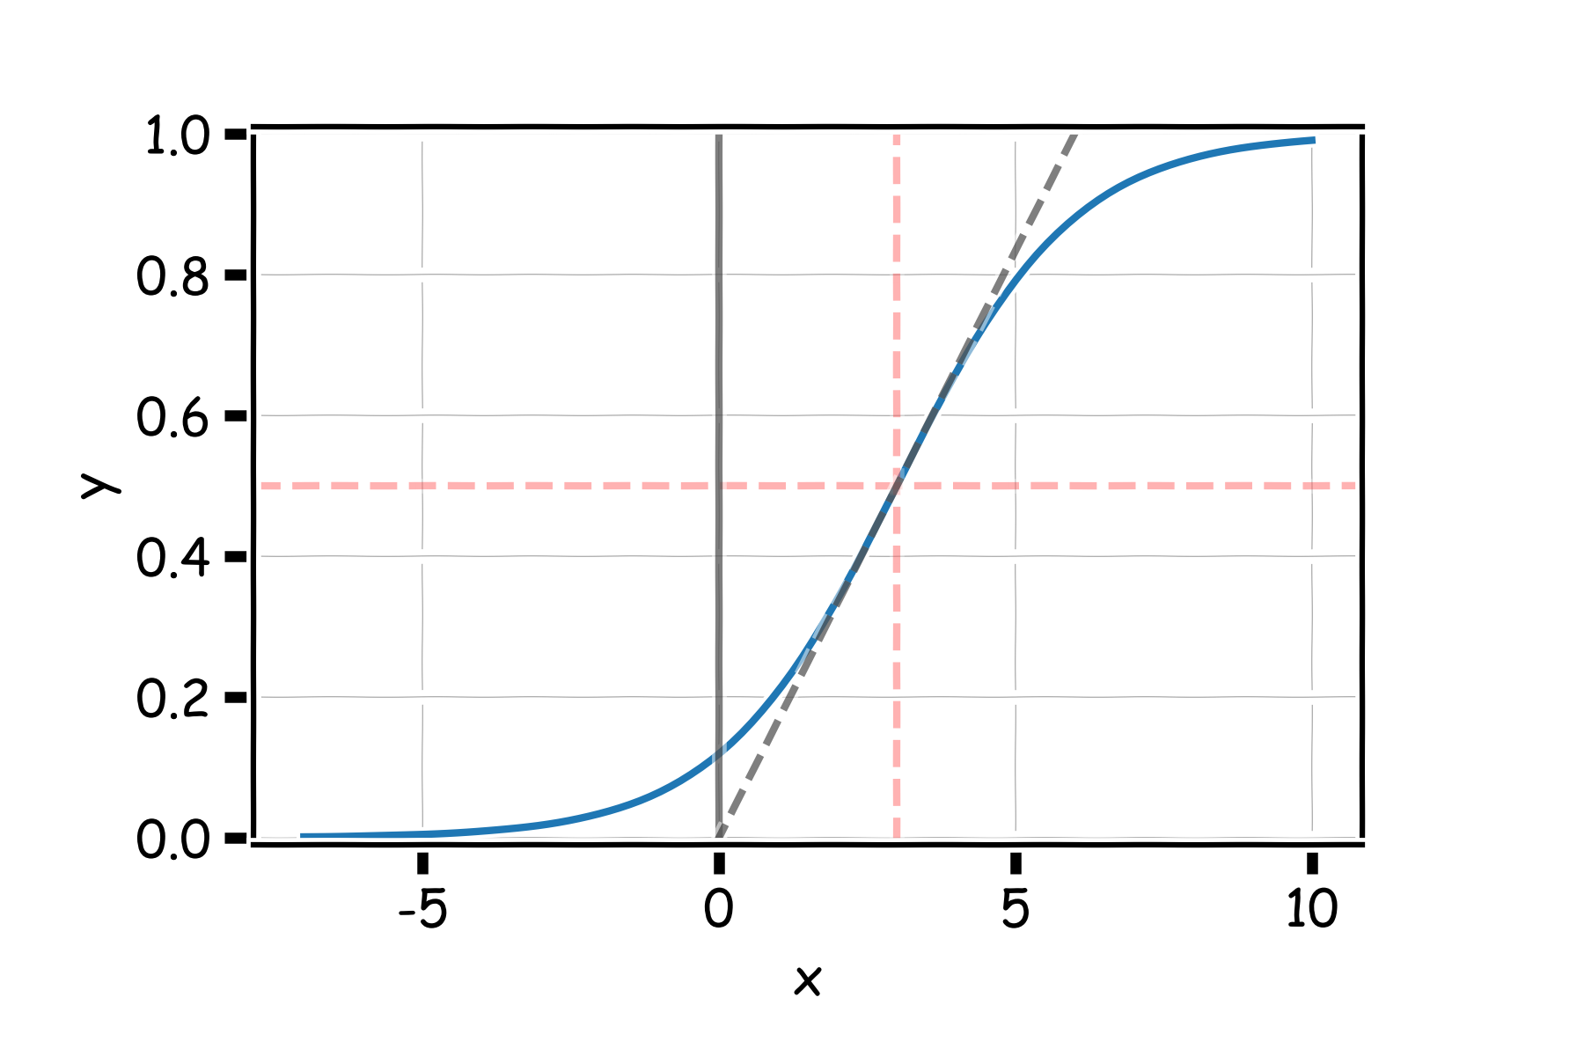
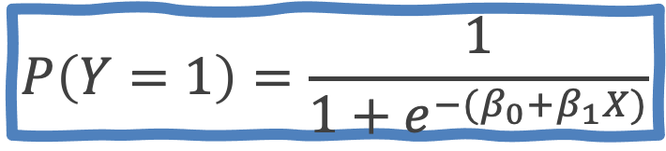
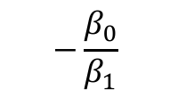
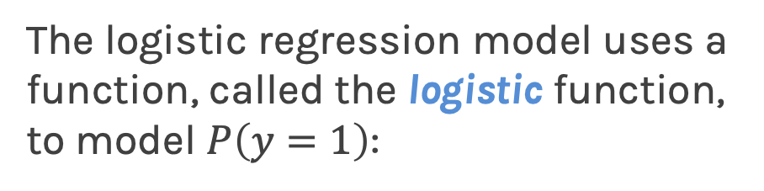
Heart Data: logistic estimation
We'd like to predict whether or not a person has a heart disease. And we'd like to make this prediction, for now, just based on the MaxHR.
The logistic regression model uses a function, called the logistic function, to model $P\left(y=1\right)$:
$$−\frac{β_{0}}{β_{1}}$$
$$P\left(Y=1\right)=\frac{1}{1+e^{−{(β}_{0}+β_{1}X)}}$$

Slide 14
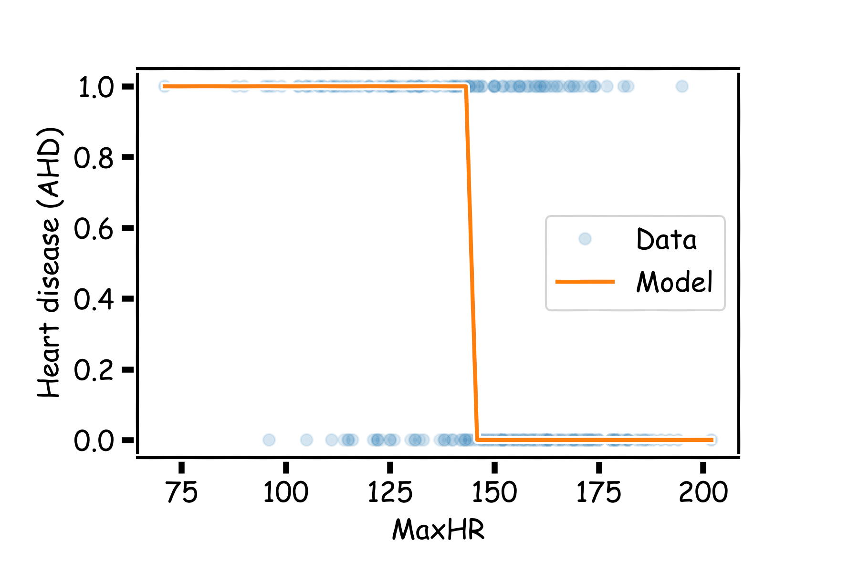
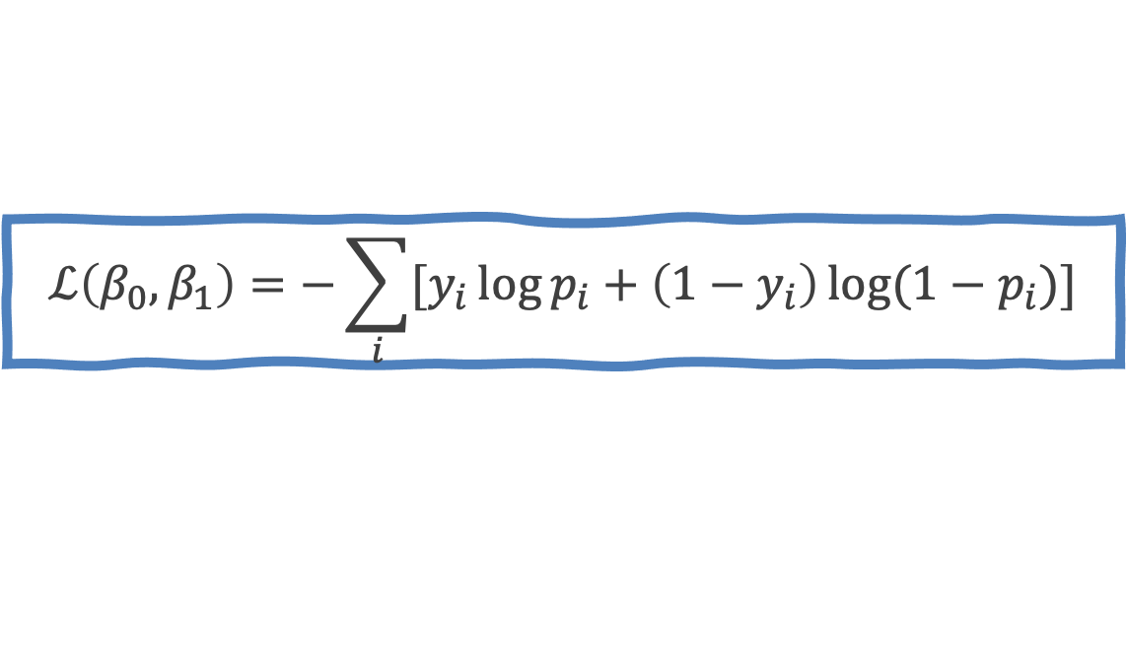
Logistic Regression
Find the coefficients that minimize the loss function
$$ℒ\left(β_{0}, β_{1}\right)=−\sum_{i}{[y_{i}\log{p_{i}+\left(1−y_{i}\right)\log{(1−p_{i})]}}}$$

Slide 15
Outline
Introduction to Artificial Neural Networks
Review of basic concepts
Single Neuron Network (‘Perceptron’)
Multi-Layer Perceptron (MLP)

Slide 16
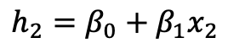
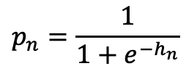
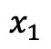
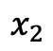
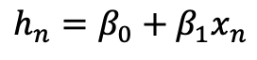
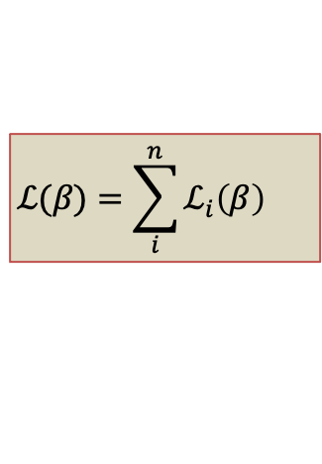
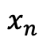
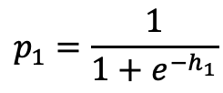
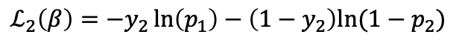
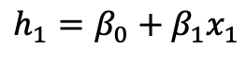
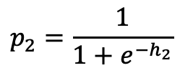
Logistic Regression Revisited
True y
$$x_{1}$$
Affine
$$h_{1}=β_{0}+β_{1}x_{1}$$
$$p_{1}=\frac{1}{1+e^{−h_{1}}}$$
Loss Fun
Activation
$$ℒ_{1}\left(β\right)=−y_{1}\ln\left(p_{1}\right)−\left(1−y_{1}\right)ln⁡(1−p_{1})$$
$$x_{2}$$
Affine
$$h_{2}=β_{0}+β_{1}x_{2}$$
$$p_{2}=\frac{1}{1+e^{−h_{2}}}$$
Loss Fun
Activation
$$ℒ_{2}\left(β\right)=−y_{2}\ln\left(p_{1}\right)−\left(1−y_{2}\right)ln⁡(1−p_{2})$$
…
…
…
$$x_{n}$$
Affine
$$h_{n}=β_{0}+β_{1}x_{n}$$
$$p_{n}=\frac{1}{1+e^{−h_{n}}}$$
Loss Fun
Activation
$$ℒ_{n}\left(β\right)=−y_{n}\ln\left(p_{n}\right)−\left(1−y_{n}\right)ln⁡(1−p_{1n})$$
$$ℒ(β)=\sum_{i}^{n}{ℒ_{i}\left(β\right)}$$

Slide 17
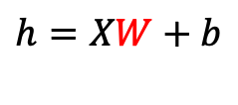
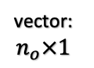
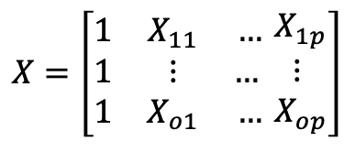


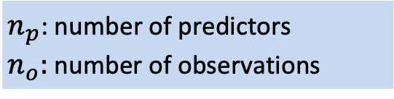
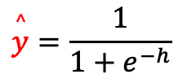
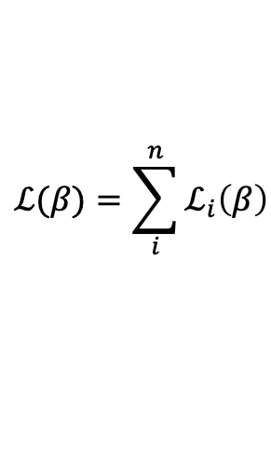
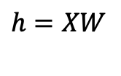
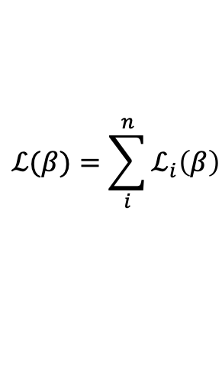
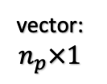
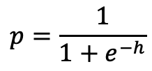

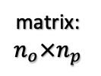
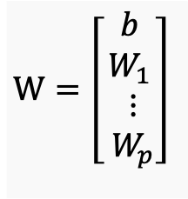
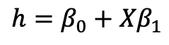
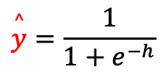
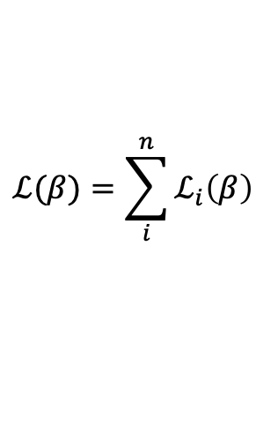
Build our first ANN
$n_{p}$: number of predictors
$n_{o}:$ number of observations
matrix: $n_{o}×n_{p}$
vector: $n_{o}×1$
vector: $n_{p}×1$
$$p=\frac{1}{1+e^{−h}}$$
$$ℒ(β)=\sum_{i}^{n}{ℒ_{i}\left(β\right)}$$
$$X$$
Affine
$$h=β_{0}+{Xβ}_{1}$$
Activation
Loss Fun
scalar
$$\overset{^}{y}=\frac{1}{1+e^{−h}}$$
$$ℒ(β)=\sum_{i}^{n}{ℒ_{i}\left(β\right)}$$
$$X$$
Affine
$$h=XW+b$$
Activation
Loss Fun
$$\overset{^}{y}=\frac{1}{1+e^{−h}}$$
$$ℒ(β)=\sum_{i}^{n}{ℒ_{i}\left(β\right)}$$
$$X$$
Affine
$$h=XW$$
Activation
Loss Fun
$$W=\left[\begin{aligned}b \\ W_{1} \\ \begin{aligned}⋮ \\ W_{p}\end{aligned}\end{aligned}\right]$$
$$X=\left[\begin{matrix}1 & X_{11} & … \\ 1 & ⋮ & … \\ 1 & X_{o1} & …\end{matrix}\begin{aligned} X_{1p} \\ ⋮ \\ X_{op}\end{aligned}\right]$$

Slide 18



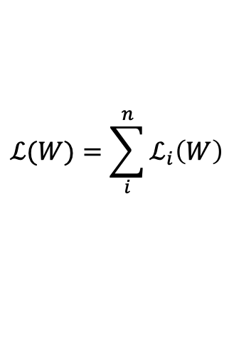
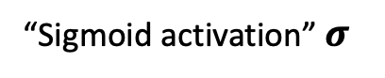
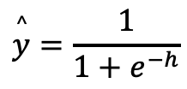
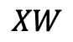
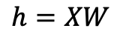
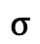
Build our first ANN
$$\overset{^}{y}=\frac{1}{1+e^{−h}}$$
$$ℒ(W)=\sum_{i}^{n}{ℒ_{i}\left(W\right)}$$
$$X$$
Affine
$$h=XW$$
Activation
Loss Fun
“Sigmoid activation” $σ$
$$XW$$
$$σ$$
$$Y$$
$$X$$
Single Neuron Network
aka Perceptron

Slide 19
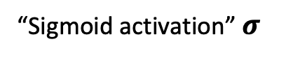
Build our first ANN
$$\overset{^}{y}=\frac{1}{1+e^{−h}}$$
$$ℒ(W)=\sum_{i}^{n}{ℒ_{i}\left(W\right)}$$
$$X$$
Affine
$$h=XW$$
Activation
Loss Fun
“Sigmoid activation” $σ$
$$XW$$
$$σ$$
$$Y$$
$$X$$
Single Neuron Network
aka Perceptron

Slide 21
Today’s lucky student: NOT PAVLOS Build a Single Neuron by Hand

